Slide 1
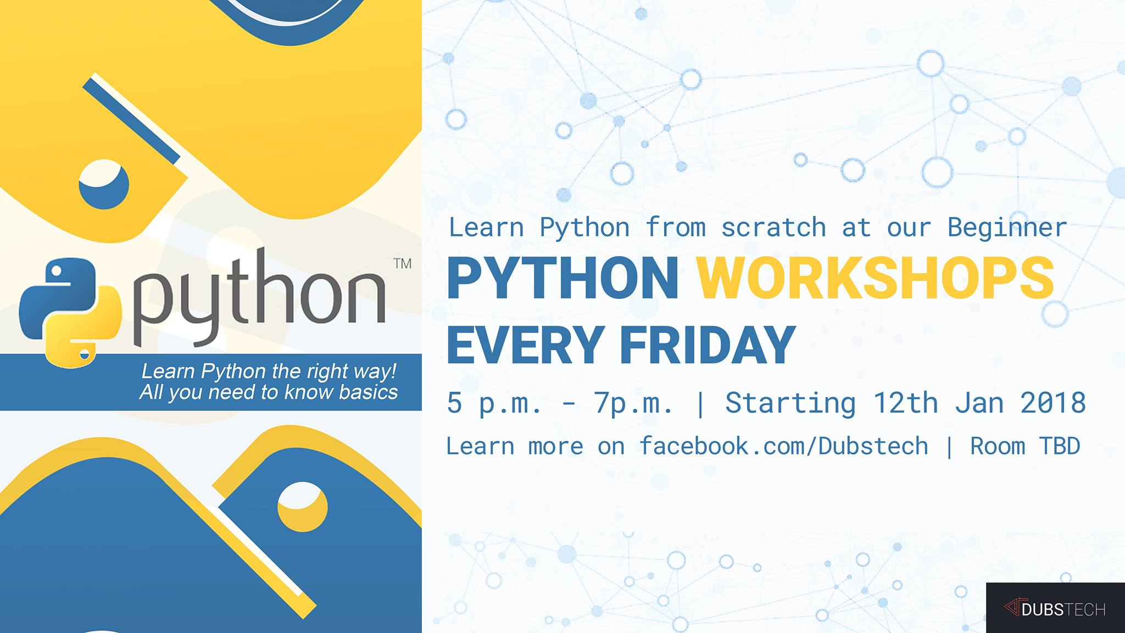

Slide 2

Fun with Python
DubsTech Coding Intro Workshop
Bowen Xu
bwx074@uw.edu

Slide 3
Welcome to DubsTech!
A UW RSO for diversified tech fields
Aiming to bring the coolest tech to everyone

Slide 4
About the Coding Intro Workshop
Learn how to code in Python
Explore your interest in coding
New projects every workshop
All you need to do: bring your laptop
No rushing, no homework, no stress!
All workshop resources can be found at https://goo.gl/2dRXAT

Slide 5
How the workshop works
Show you how the project works
Talk about the general aspect(s) behind it
Walk you through the coding
That’s it! Everyone will get their projects completed
Show your projects to your friends! Help us grow!

Slide 6
New to Workshop? Missing a session?
The following resources will be available
Past PowerPoints
Completed workshop projects
You may work on the old ones on your own
I will be able to help you in coding sessions and via email

Slide 7
Workshop 1 Review
We’ve talked about the following in workshop 1:
Indentation is vital to Python
Initializing variables
Method basics
How to declare a new method
Void method vs. returning method
Generate random numbers
Boolean zen
The idea of test each functionality (method) before moving on
If/else iterations
Workshop1Review.py

Slide 8
Workshop 2: Magic 3
Magic3.py
Simplified version of Magic 8:
We limit the responses to yes/no/maybe
What does the program need to do?
How does it ask and echo the question?
How does it make a random response each time?
How does it repeat asking over a set time?

Slide 9
Magic3.py - breakdown
I/O (generic)
If/else (generic)
Generating random response (original)
Random numbers (generic)
Restricted while loop (generic, with original restrictions)

Slide 10
Let’s get started…
Name your new program magic3.py and work on get_response(), very similar to roll()
This time, you want the random numbers to be in the range of 1 to 3
Let’s then work on our main() method:
Before the loop, we want the user to input a proper number of “play_times”
User_input is of the type string, one of the primitive data types that Python provides
How do you check if the user_input was an integer? If so, how do you convert user_input back to int (integer)?
What should you do if the user_input was not an integer, or if it’s something too big to be practical?

Slide 11
Python data types
string = “abc”
integer = 123
Input() returns a string, so we need to convert the string back to integer
More data types will be introduced in the future

Slide 12
If this and that…
If (user_input is numeric) and (converted user_input <100):
(set play_times to be user_input)
else:
(print out error message and use a default value)
*(Pseudo code goes inside)
**100 is just a number chosen to be an “upper limit” for proper play_times

Slide 13
If this and that…
If user_input is not numeric, Python won’t worry about converting it (evaluating what’s after “and”
Short circuit execution
When you feel like you’ve stumbled upon some generic functions but don’t exactly know them, Google them!
Try keywords like “python convert string to int”
if user_input.isdigit() and int(user_input) < 100:
If both conditions evaluate to be True, don’t forget to cast user_input to int!
defaultValues.py

Slide 14
The number 3 keeps popping up…
We’ve decided the number 3 to be both the number of responses, and the default number of play_times
Is there a way to avoid having 3 directly in the codes and possible mistakes?

Slide 15
Global Variables
Declare at the beginning of the program
Import random
NUM_OF_RESPONSES = 3 # it’s best to capitalize all the letters!
…
Accessible to all the methods
Avoid duplicates
globalVar.py

Slide 16
Infinite vs Restricted while loop
LoopedDice.py
What if the user rolls the dice… forever?
Infinite loops are BAD!
Consumes CPU time and memory
Can crash your system
Good idea to restrict how many times your loop runs

Slide 17
While things are not done…
To write a restricted while loop:
Declare a Boolean variable OR set up a restricted condition
While this variable/condition is true, do something
Inside while loop, write if statements to set the variable to be false (and end the loop) OR alter the condition so at some point it no longer satisfies loop condition

Slide 18
While things are not done…
While play_times > 0: #when user can still play
(get input from user)
(echo the question)
(call get_response() and print() responses accordingly)
play_times = play_times – 1 # substracts play_times by 1
print ("Thanks for playing.")

Slide 19
While things are not done…
3 responses -> yes/no/maybe
How can you print() different things based on different get_response() values?
If (something):
elif(something else):
else: #when none of the above is true
Magic3.py

Slide 20
Reflections
What if we have a hundred responses to deal with?
Arrays? Data structures? (Future Workshops)
See you in Workshop 3, where we do more practice on what we’ve learned and make our “guess the number” game!

